Slide 1
A/B Testing using RL
mquazi@buffalo.edu

Slide 2
What is A/B Testing
Also known as Split Testing
Randomized experimentation process where we compare performance of 2 or more versions of a single variable.

Slide 3
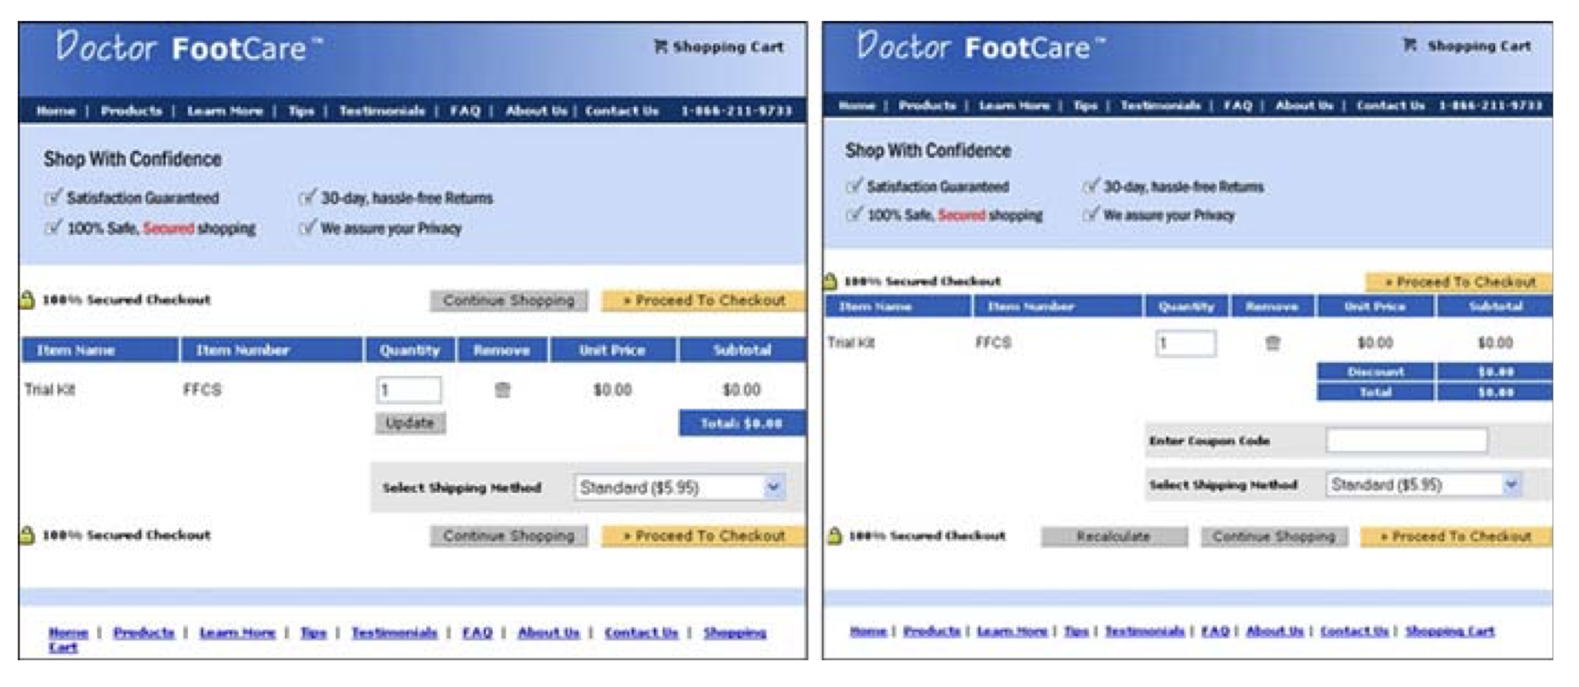
http://www.robotics.stanford.edu/~ronnyk/2009controlledExperimentsOnTheWebSurvey.pdf

Slide 4
https://www.youtube.com/watch?v=GaP5f0jVTWE

Slide 5
How do we A/B test?
Using Multi Armed Bandit RL algorithms.
Different variants available – MAB Epsilon Greedy, MAB UCB, MAB Thompson Sampling

Slide 6
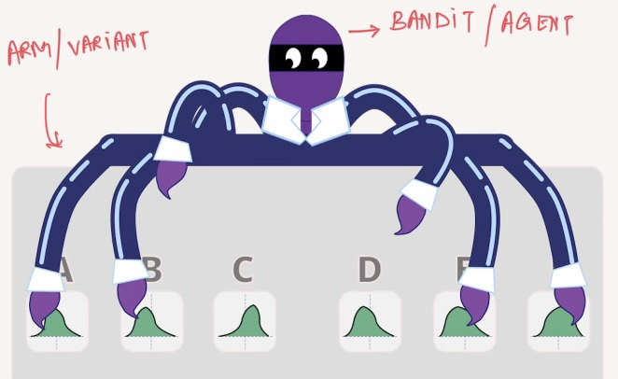
The Jargon

Slide 7
Formulating AB/Test as RL problem
Code Walkthrough of Python Flask micro service

Slide 8
Results/ Demo/ A-B Test Process
Establish Hypothesis
Perform test
Gather Data
Make business decisions

Slide 9
Improvements
Ability to visualize results using different MAB algorithms at once
Correctly preserving agent state across application reboot

Slide 10
Questions?

